Slide 1
DBSCAN

Slide 2
Learning Goals
In this section, we will cover:
- The DBSCAN algorithm
- Inputs and outputs
- Algorithm strengths and weaknesses

Slide 3
DBSCAN
Density-Based Spatial Clustering of Applications with Noise (DBSCAN)
A true clustering algorithm:
- can have points that don't belong to any cluster
Points are clustered using density of local neighborhood:
- finds core points in high density regions and expands clusters from them
Algorithm ends when all points have been classified as either belonging to a cluster or to noise.

Slide 4
DBSCAN: Inputs
Required inputs:
- Metric: function to calculate distance
- Epsilon (eps, ε): radius of local neighborhood
- N_clu: determines density threshold (for fixed ε)
Core points are those which have more than n_clu neighbors in their local neighborhood ("ε-neighborhood”).

Slide 5
DBSCAN: Outputs
Three possible labels for any point:
- Core:
• point which has more than n_clu neighbors in their ε-neighborhood
- Density-reachable:
• an ε-neighbor of a core point than has fewer than n_clu neighbors itself
- Noise:
• a point that has no core points in its ε-neighborhood
- Clusters:
• connected core and density-reachable points

Slide 6
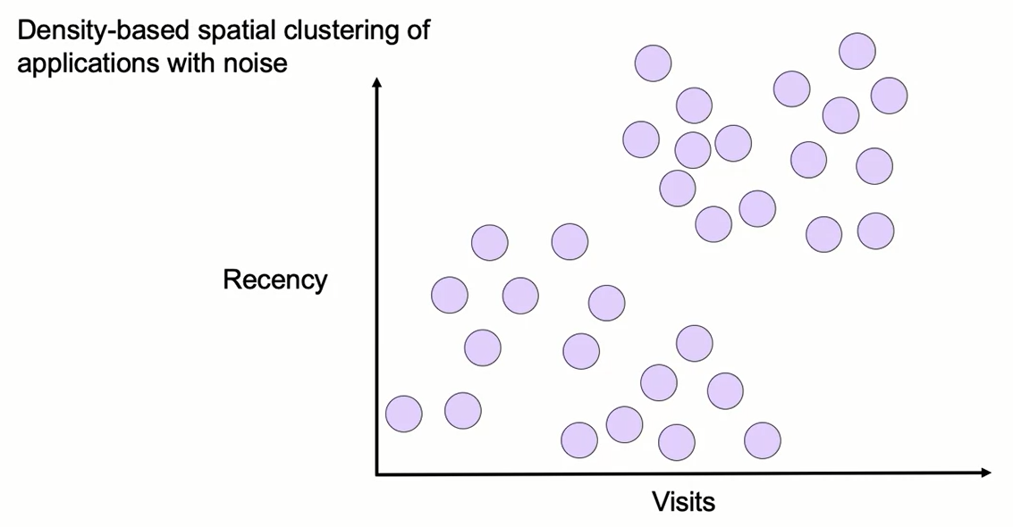
DBSCAN

Slide 7
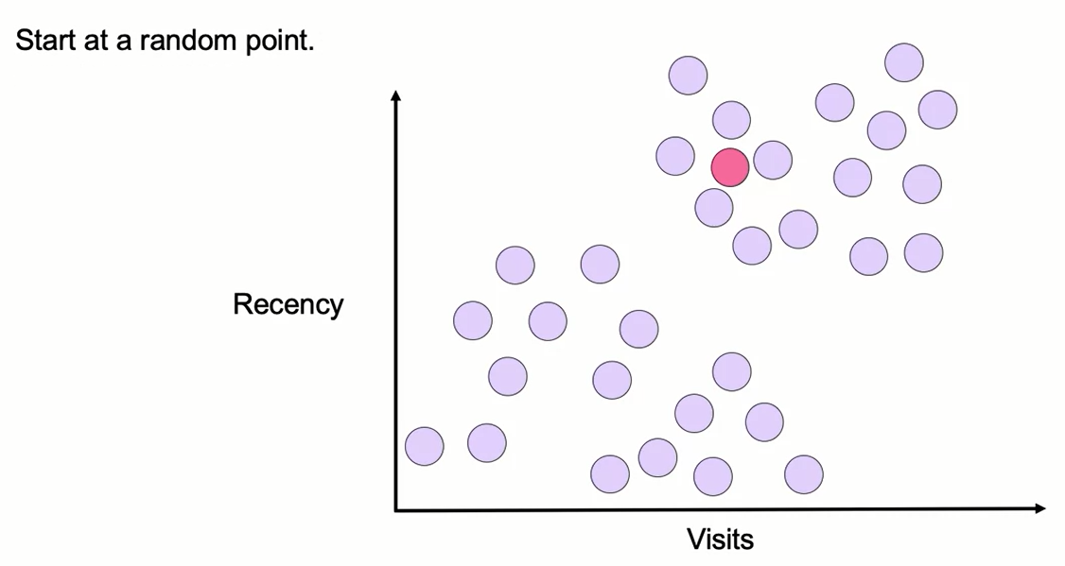
DBSCAN

Slide 8
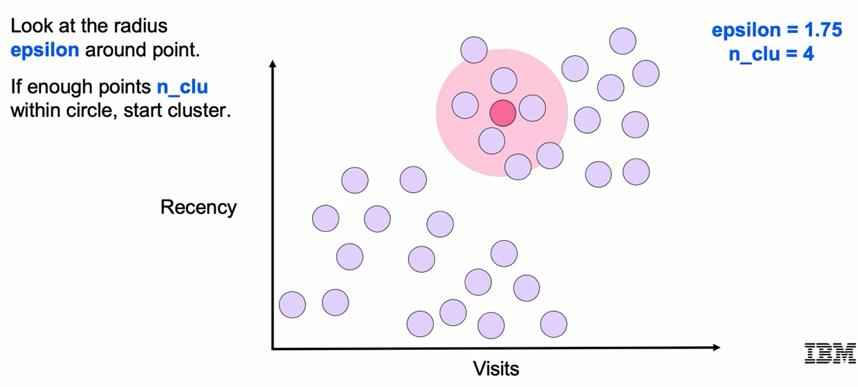
DBSCAN

Slide 9
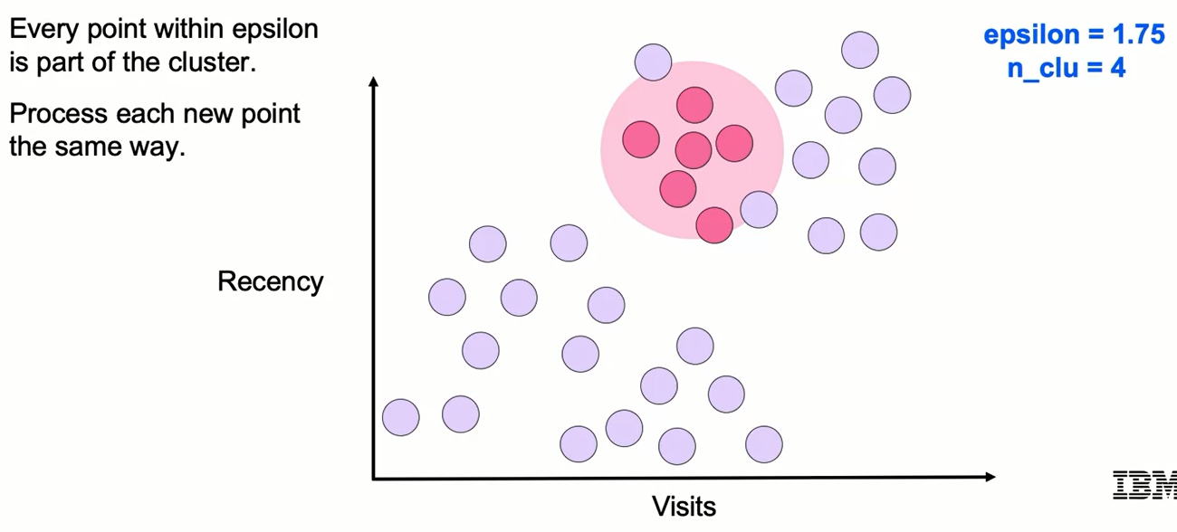
DBSCAN

Slide 10
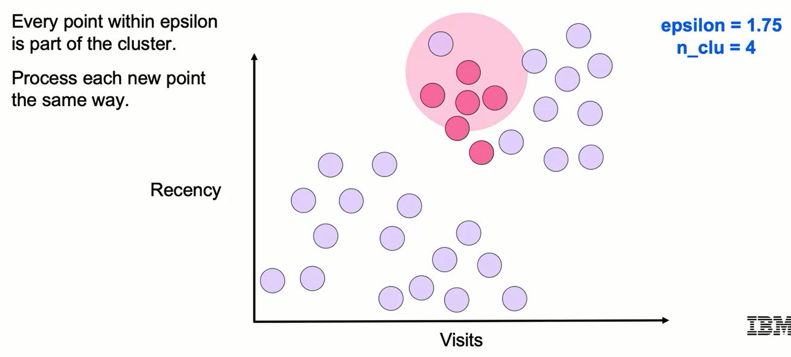
DBSCAN

Slide 11
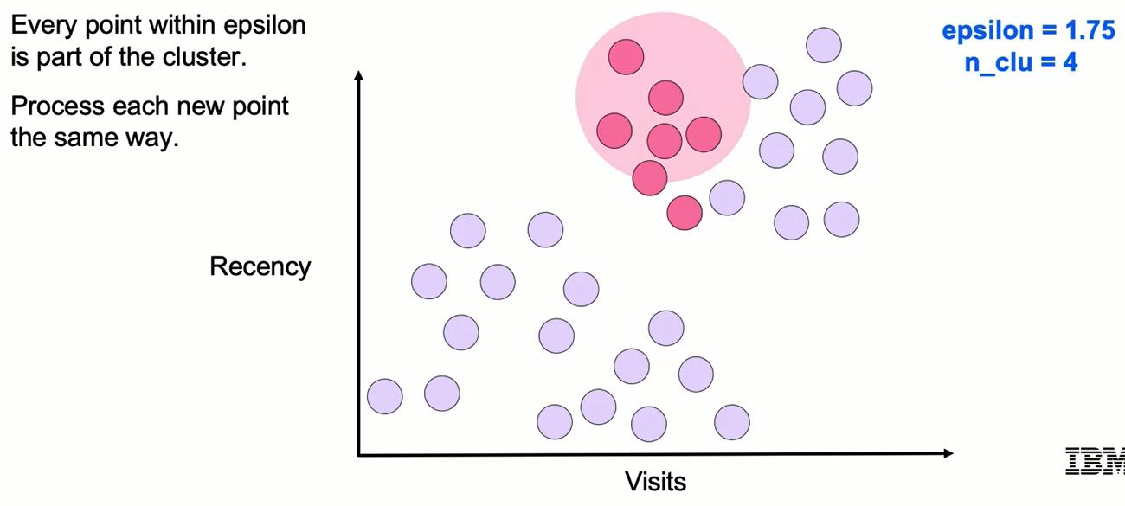
DBSCAN

Slide 12
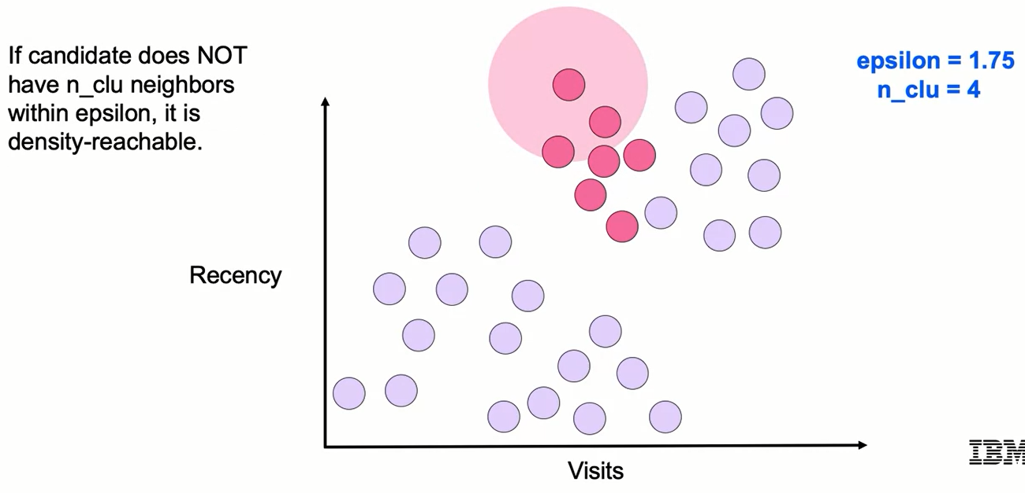
DBSCAN

Slide 13
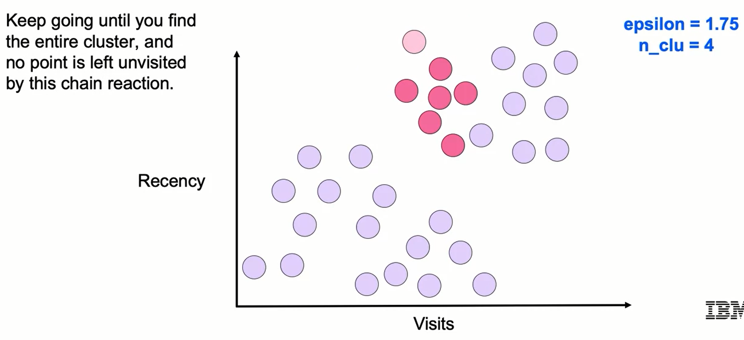
DBSCAN

Slide 14
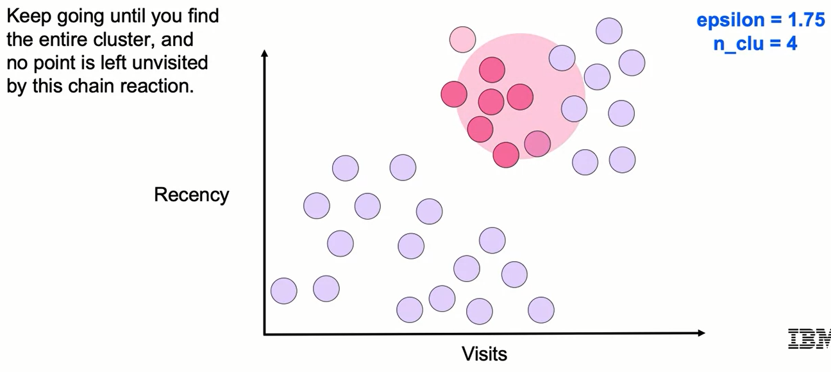
DBSCAN

Slide 15
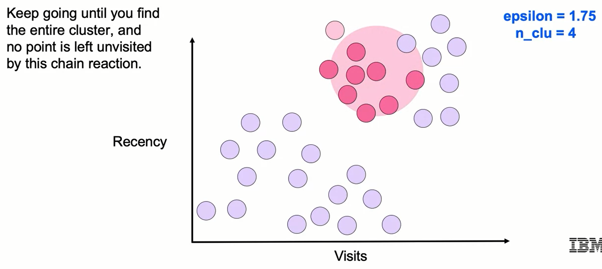
DBSCAN

Slide 16
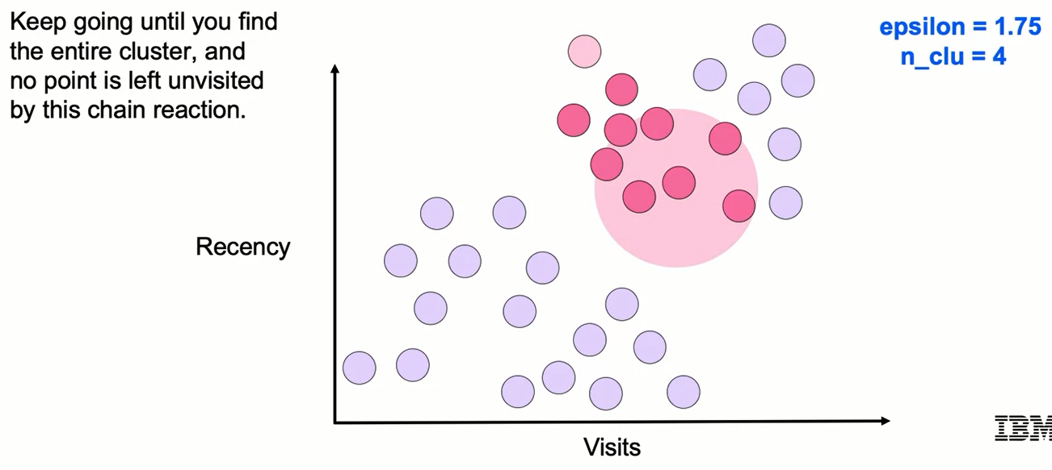
DBSCAN

Slide 17
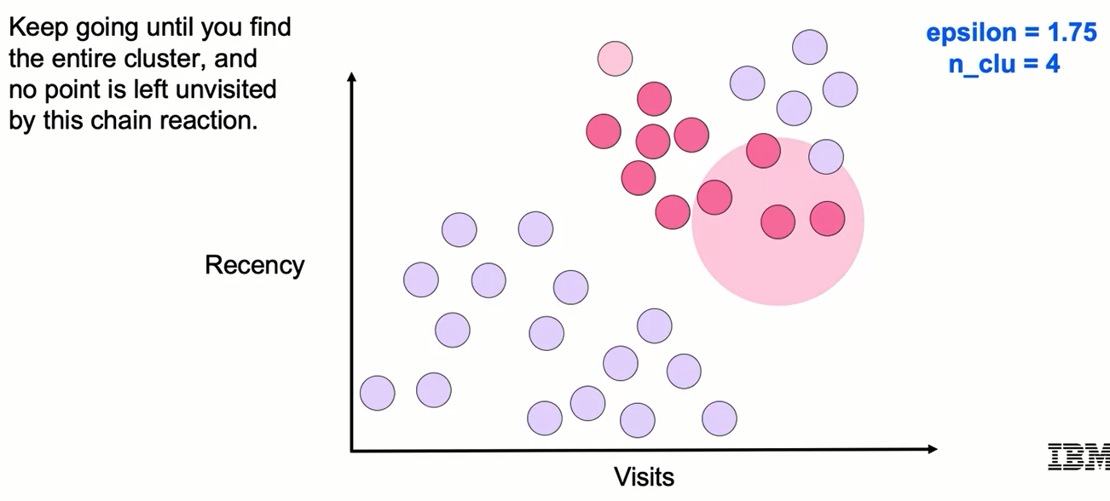
DBSCAN

Slide 18
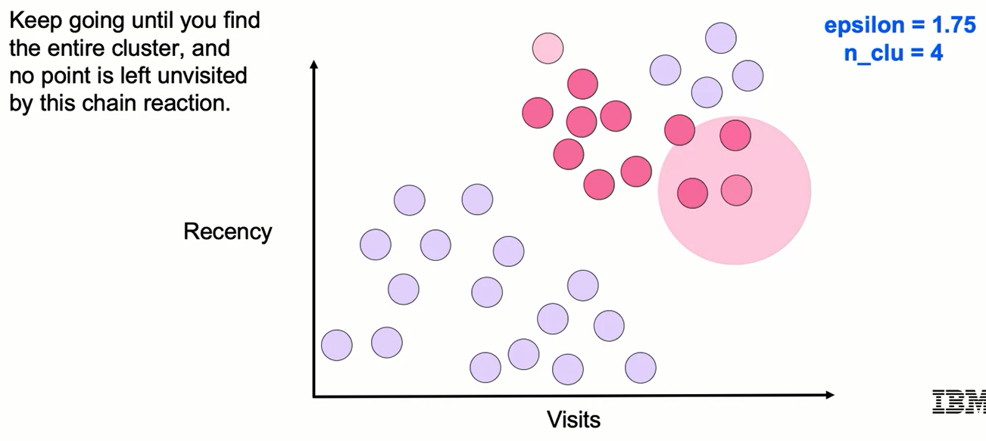
DBSCAN

Slide 19
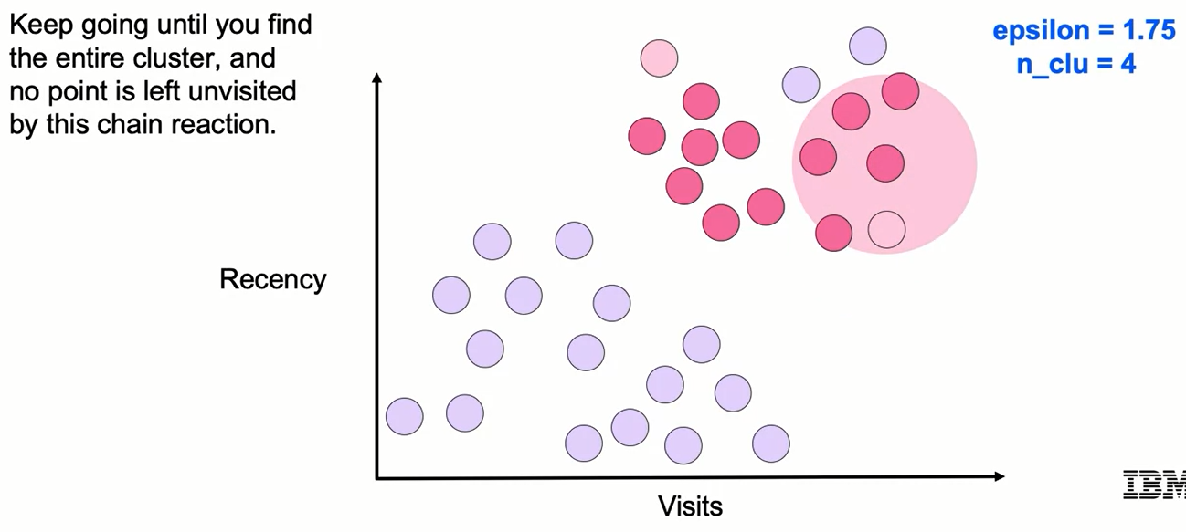
DBSCAN

Slide 20
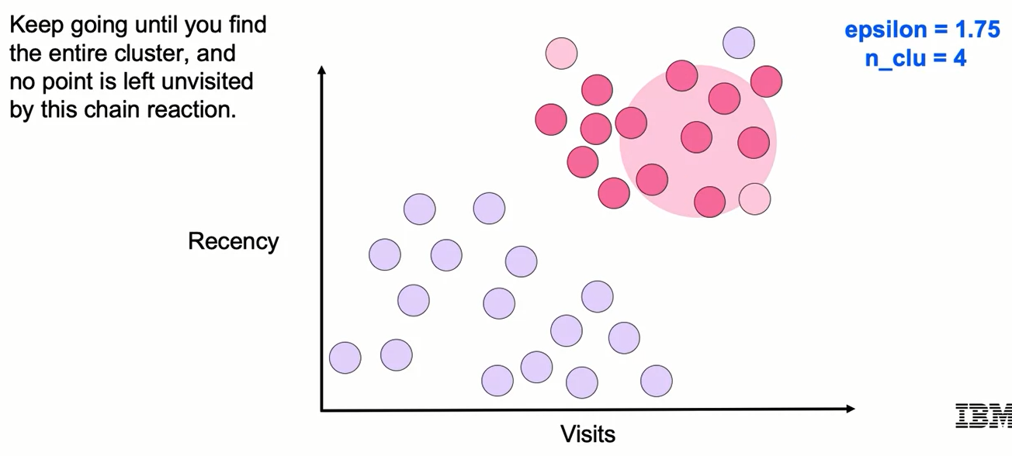
DBSCAN

Slide 21
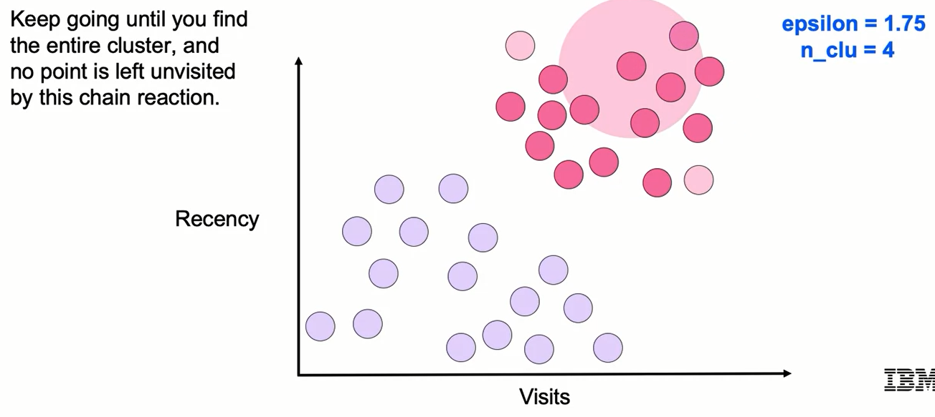
DBSCAN

Slide 22
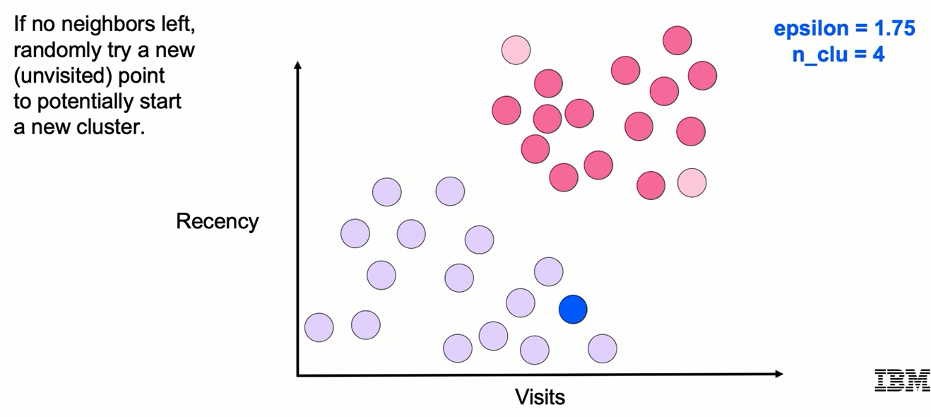
DBSCAN

Slide 23
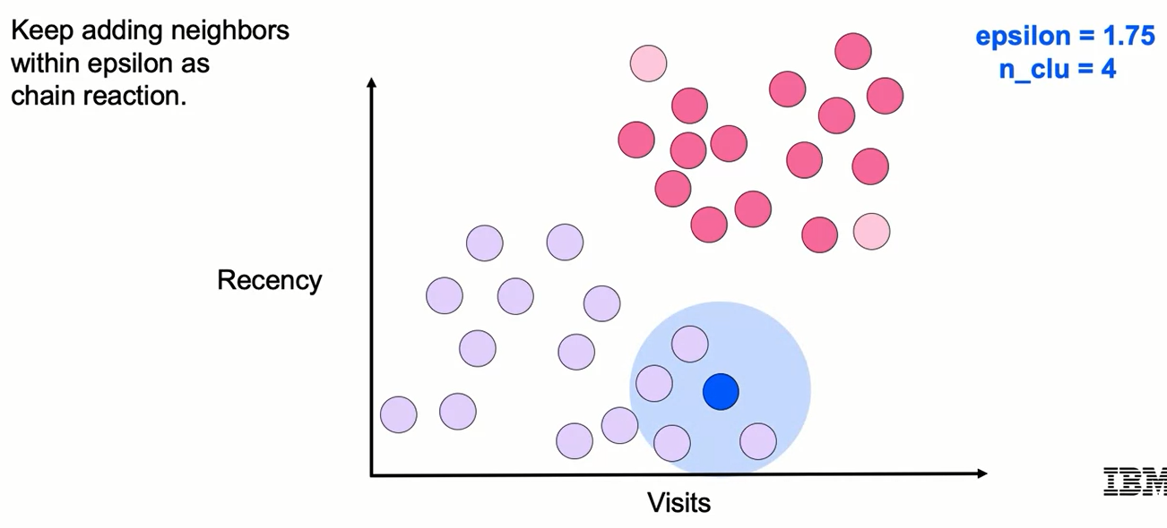
DBSCAN

Slide 24
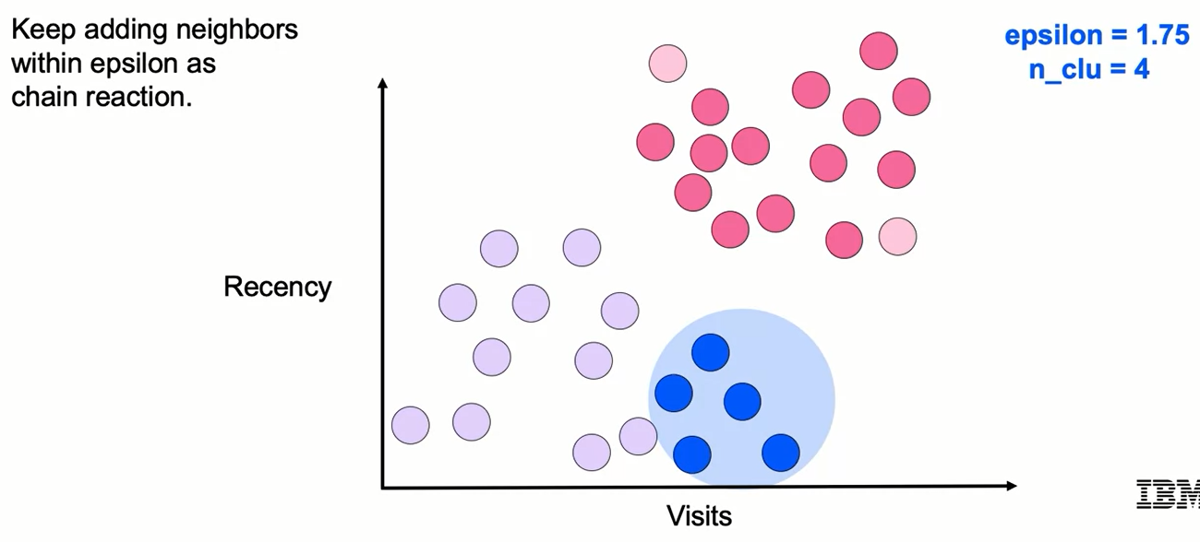
DBSCAN

Slide 25
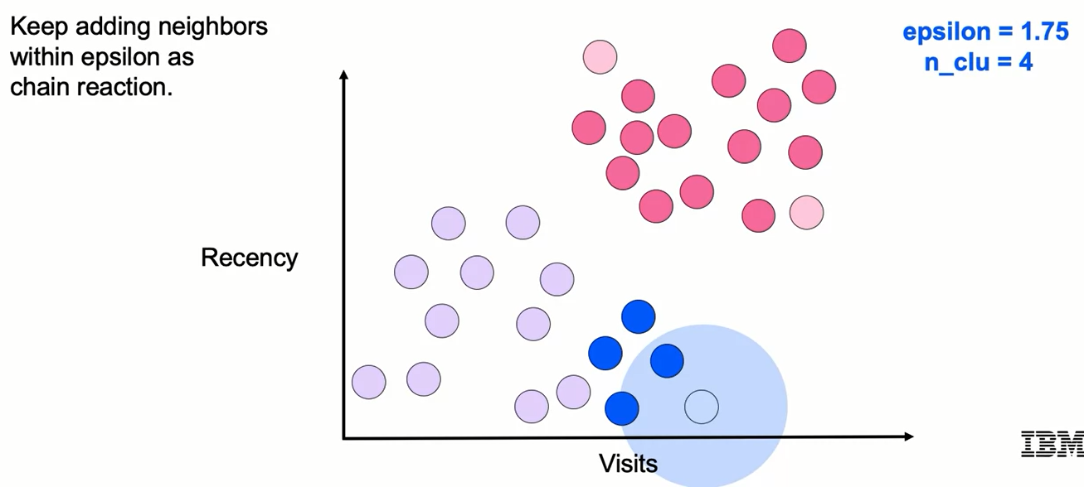
DBSCAN

Slide 26
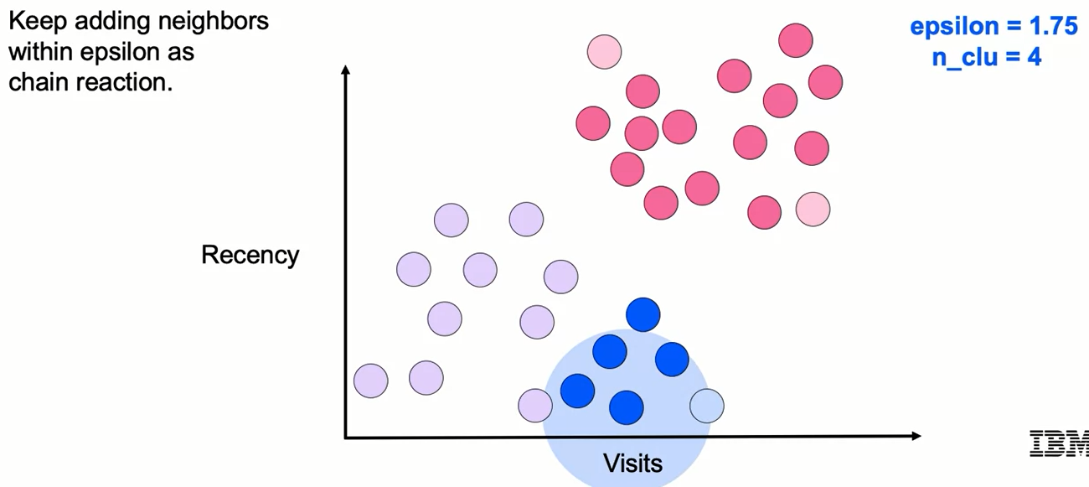
DBSCAN

Slide 27
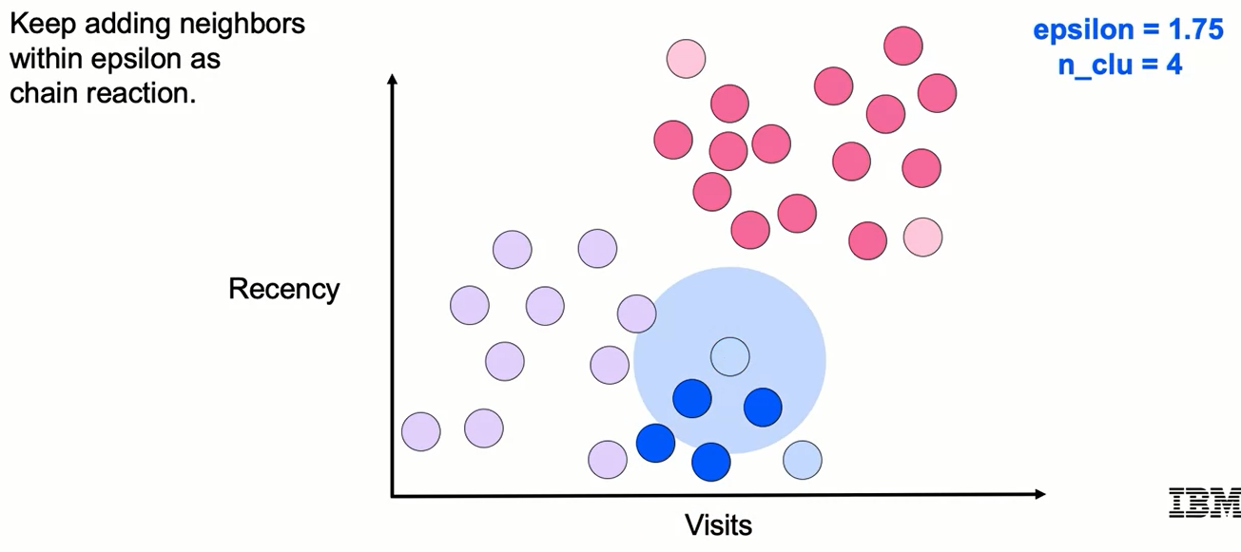
DBSCAN

Slide 28
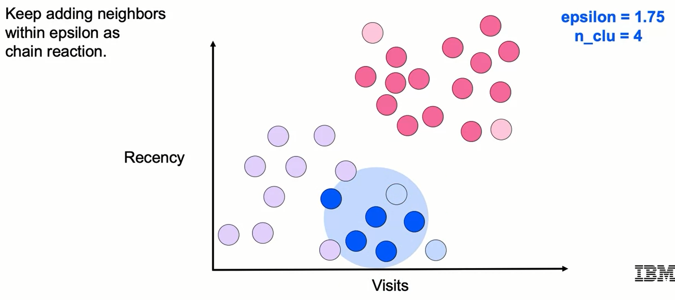
DBSCAN

Slide 29
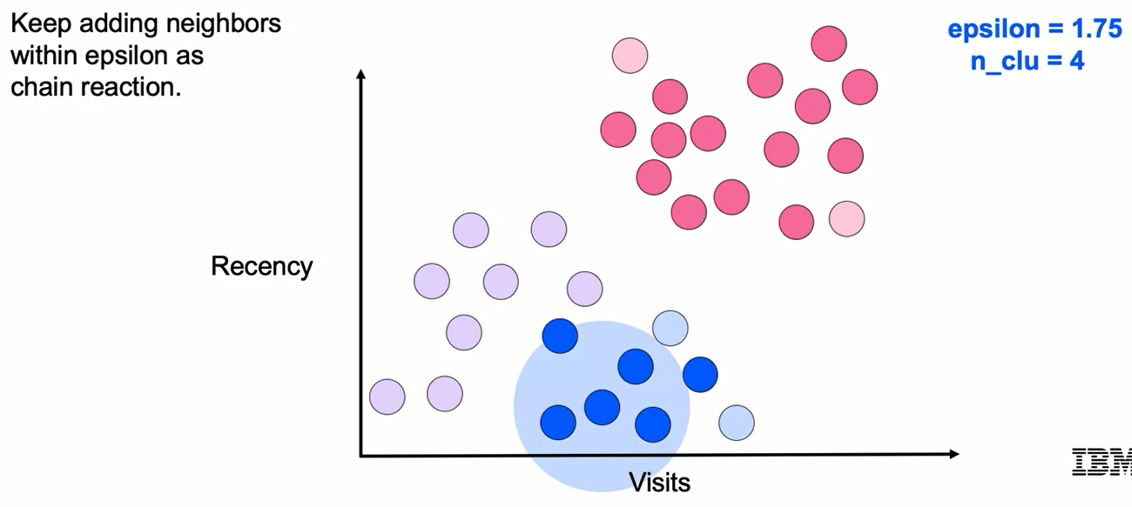
DBSCAN

Slide 30
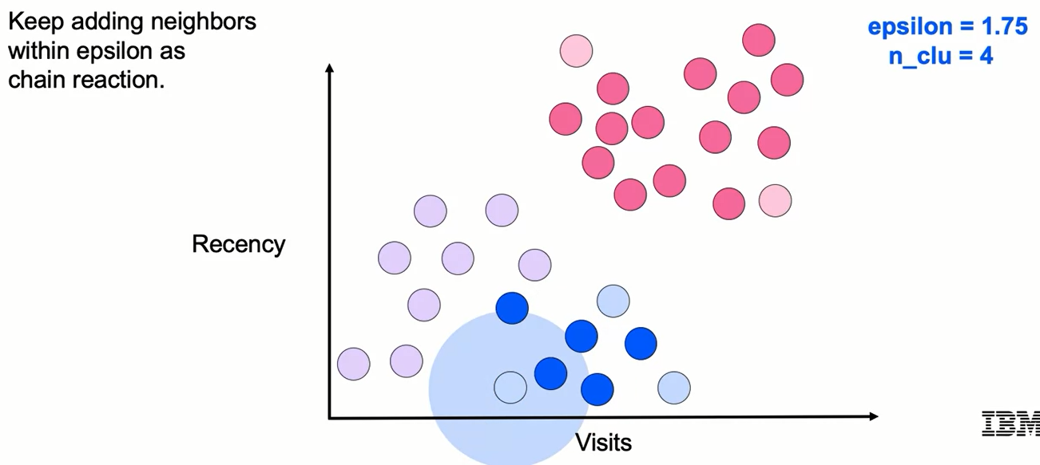
DBSCAN

Slide 31
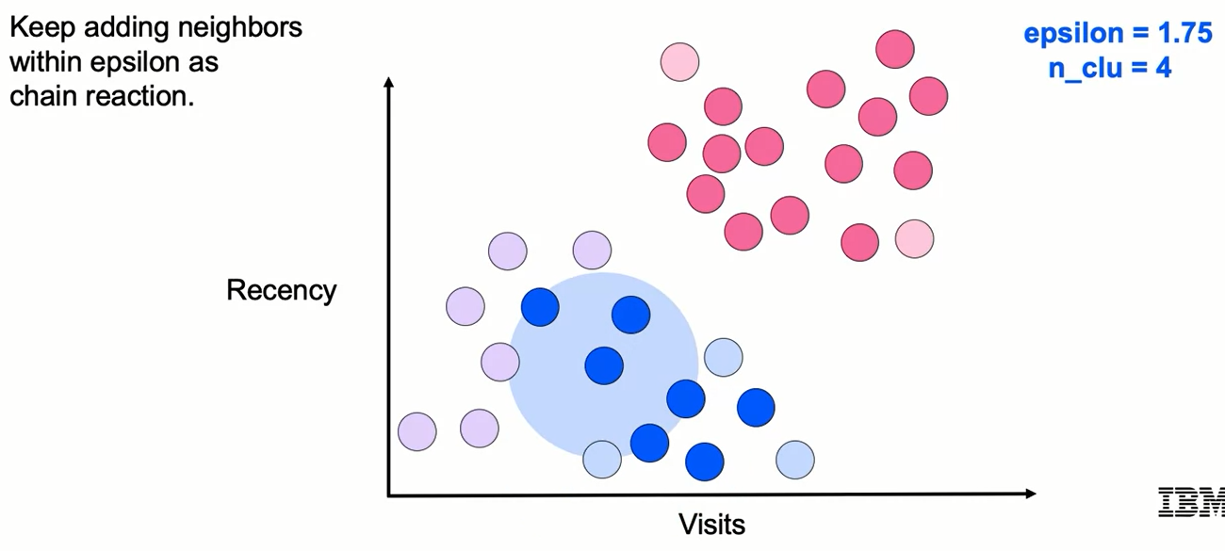
DBSCAN

Slide 32
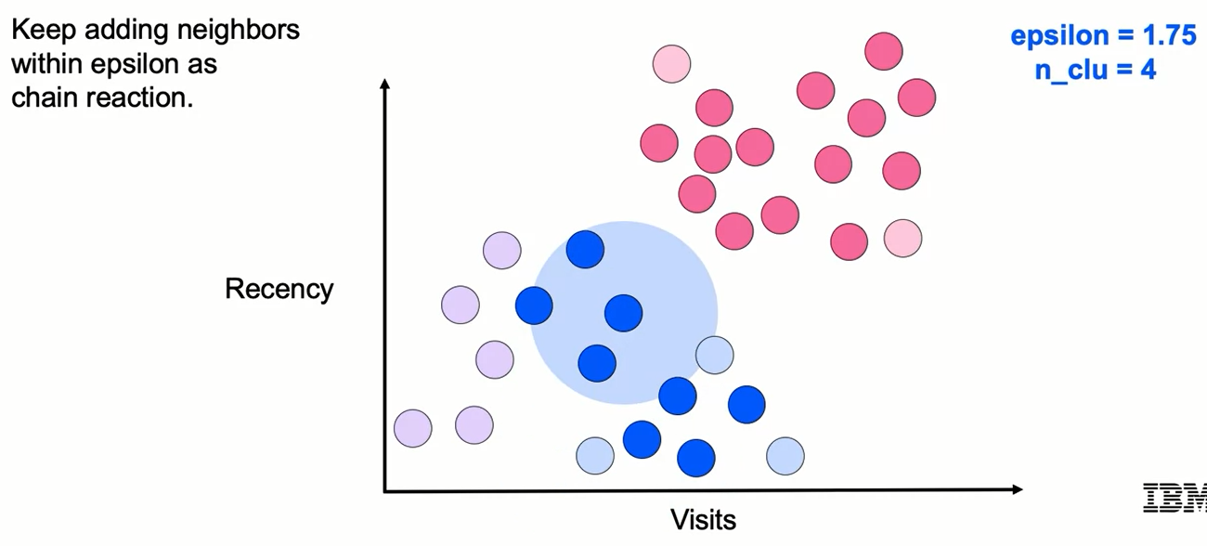
DBSCAN

Slide 33
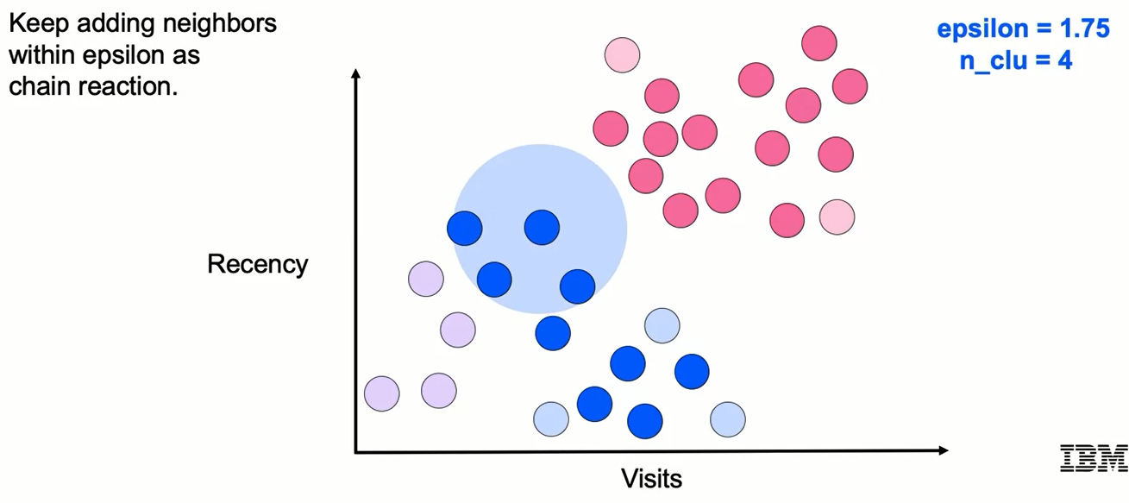
DBSCAN

Slide 34
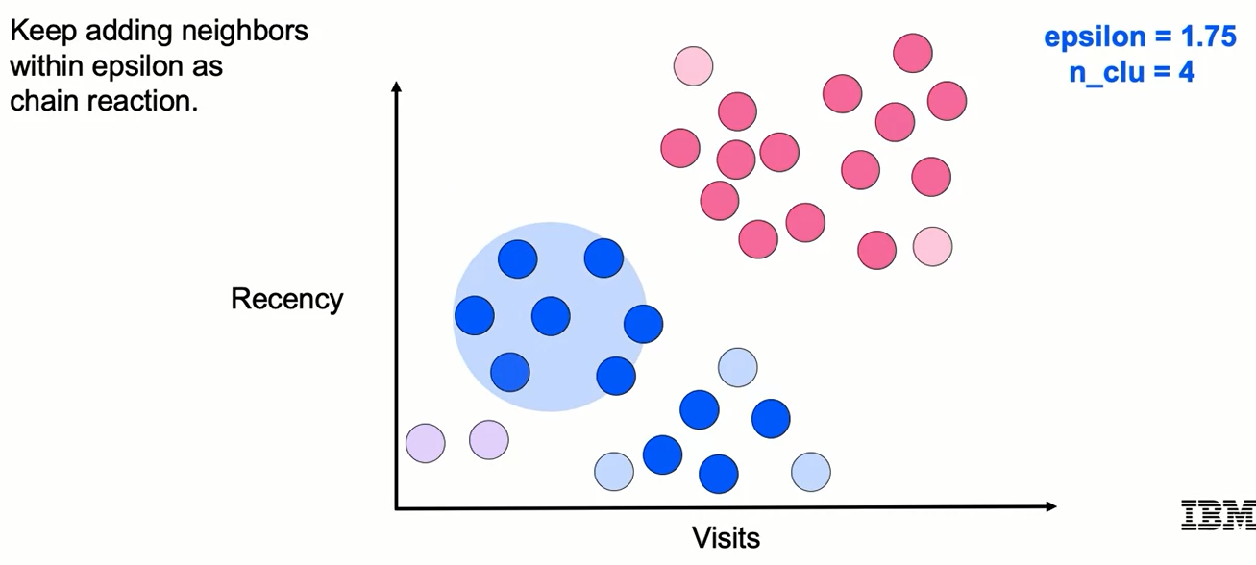
DBSCAN

Slide 35
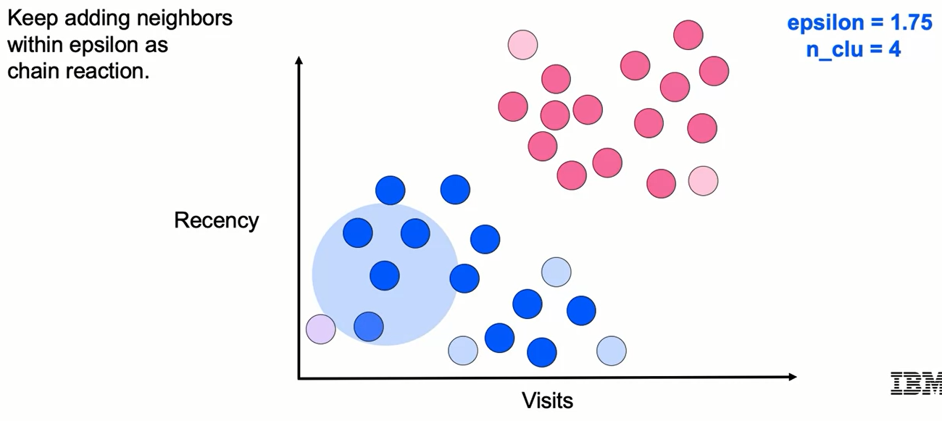
DBSCAN

Slide 36
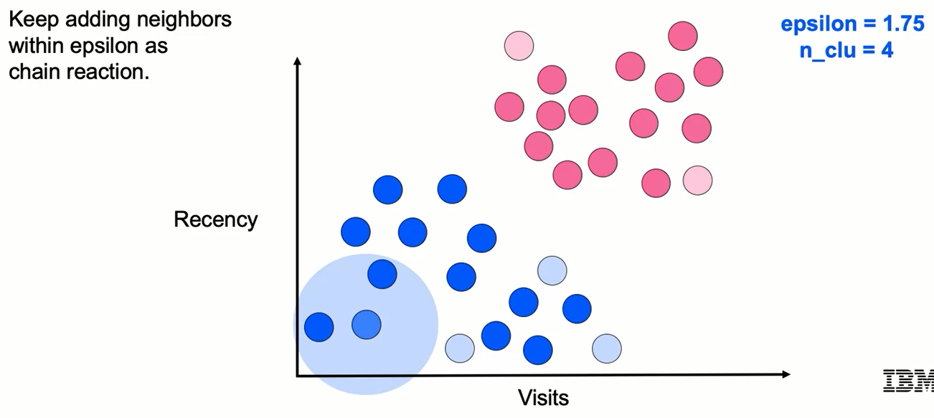
DBSCAN

Slide 37
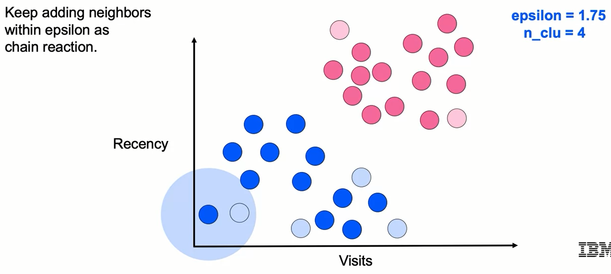
DBSCAN

Slide 38
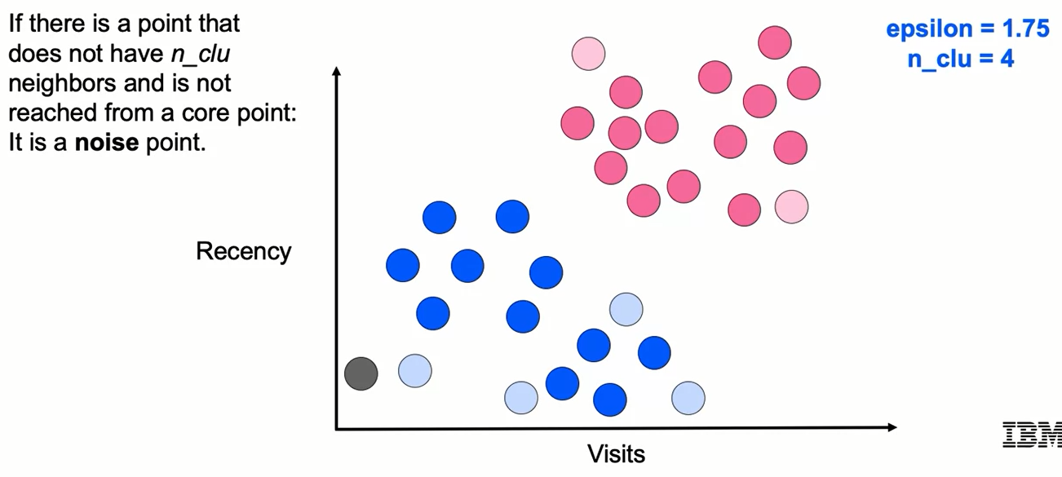
DBSCAN

Slide 39
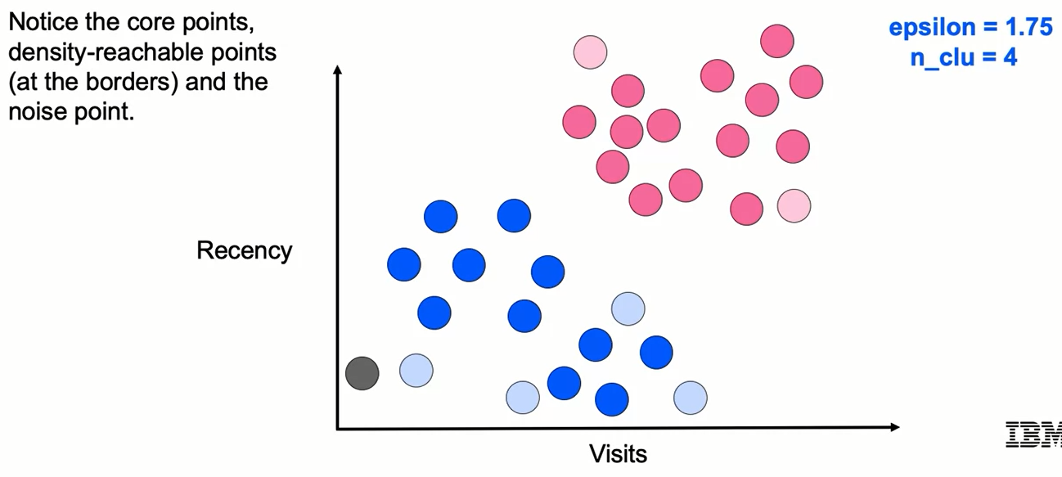
DBSCAN

Slide 40
DBSCAN: Strengths and Weaknesses
Strengths:
- No need to specify number of clusters (cf. k-means)
- Allows for noise
- Can handle arbitrary-shaped clusters
Weaknesses:
- Requires two parameters (vs. one for k-means)
- Finding appropriate values of ε and n_clu can be difficult
- Does not do well with clusters of different density

Slide 41
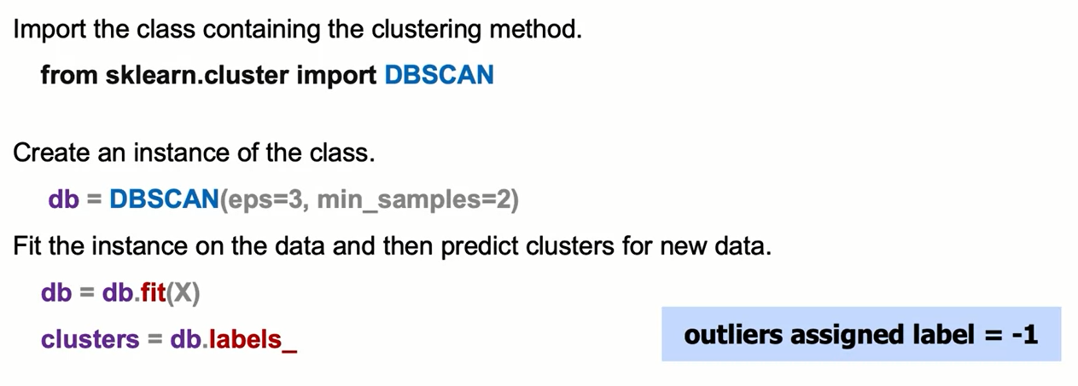
DBSCAN: the Syntax

Slide 42
Learning Recap
In this section, we discussed :
- The DBSCAN algorithm
- Inputs and outputs
- Algorithm strengths and weaknesses

